Slide 1
Honing Your Proposals & Winning Interviews
with Paul Hunkin
Notes:
I’m going to talk about honing your proposals and winning interviews.

Slide 2
Agenda
Background - Where did I start from? Where am I now?
Proposals - An evolving journey to a winning formula
Interviewing - Capture your client’s attention and close the deal
Pricing - Know Your Value
After the call - What to do
Notes:
So this is what I’m going to cover. I’m going to take you through my background briefly, so you can see where I’m coming from. And I’ll talk a bit about the common mistakes in the proposal process I made early on, and the improvements I learned to make over time. Then I’ll talk a bit about interviewing, and how you should handle that. Then pricing, and briefly I’ll cover after the call. So the entire client project acquisition and execution pipeline, basically.

Slide 3
Background
Originally from small-town (~5,000 people) New Zealand, left in Jan 2012 “for a month or two” of travel after university, then I’d “get a real job”
Finding that backpacking through South-East Asia can be more expensive than you might think, I tried my hand at finding IT work online (it was that or my parents couch again…)
Fast-forward ten years...
Still working online!
Full-stack remote software developer/consultant
Upwork top-rated-plus
Worked with big-companies and small
Big pluses: Flexibility. Location-independence. Variety. More secure (once established…)

Slide 4
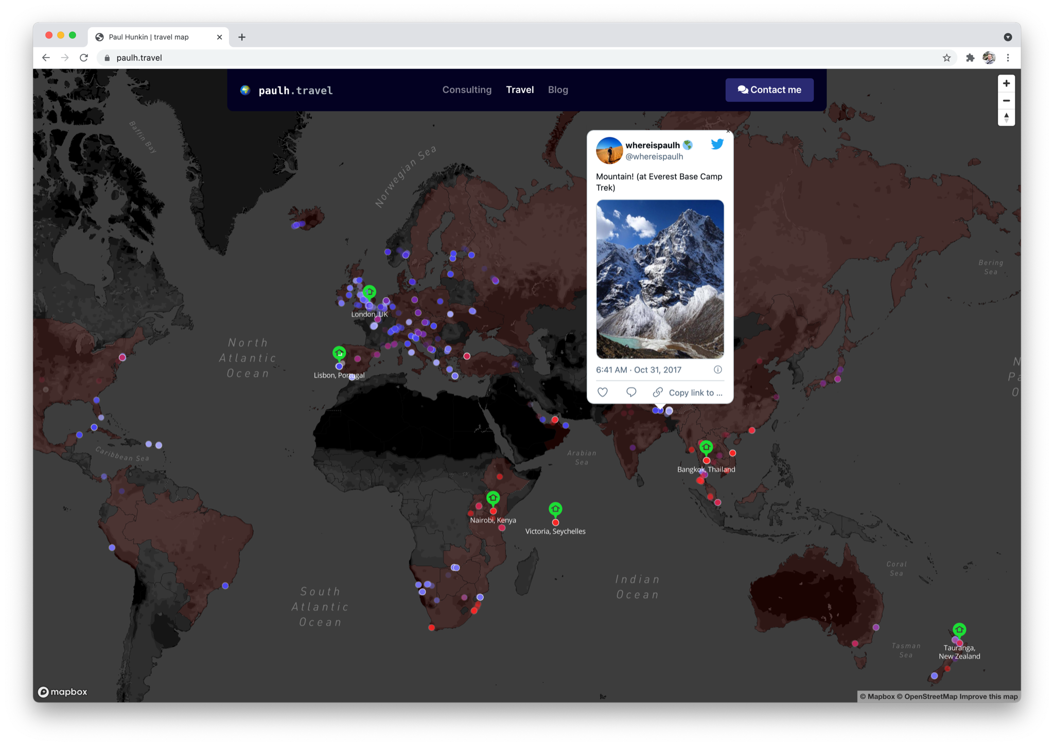
Background
Notes:
(83 countries, now living in Lisbon, Portugal
Everywhere from Austria to Zanzibar

Slide 5
Background
Notes:
Please don’t call me a digital nomad though...

Slide 6
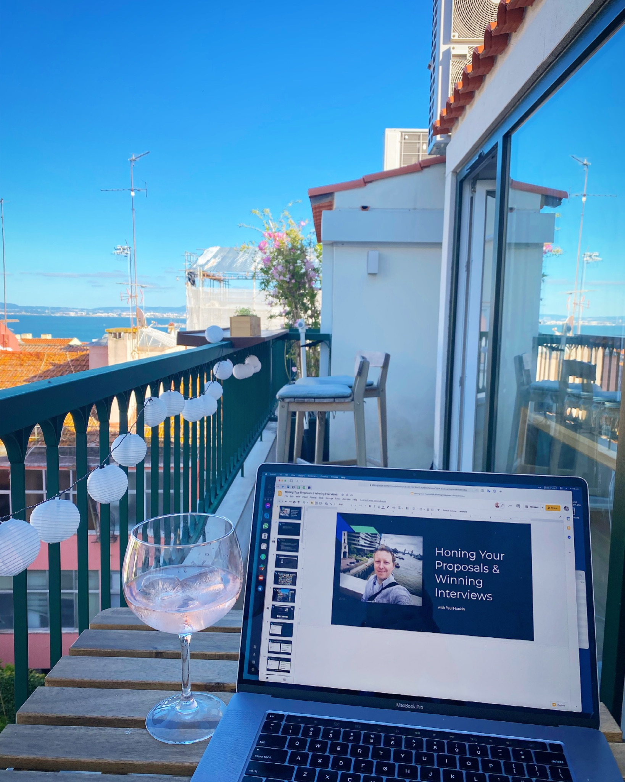
Background
Notes:
Please don’t call me a digital nomad though...

Slide 7
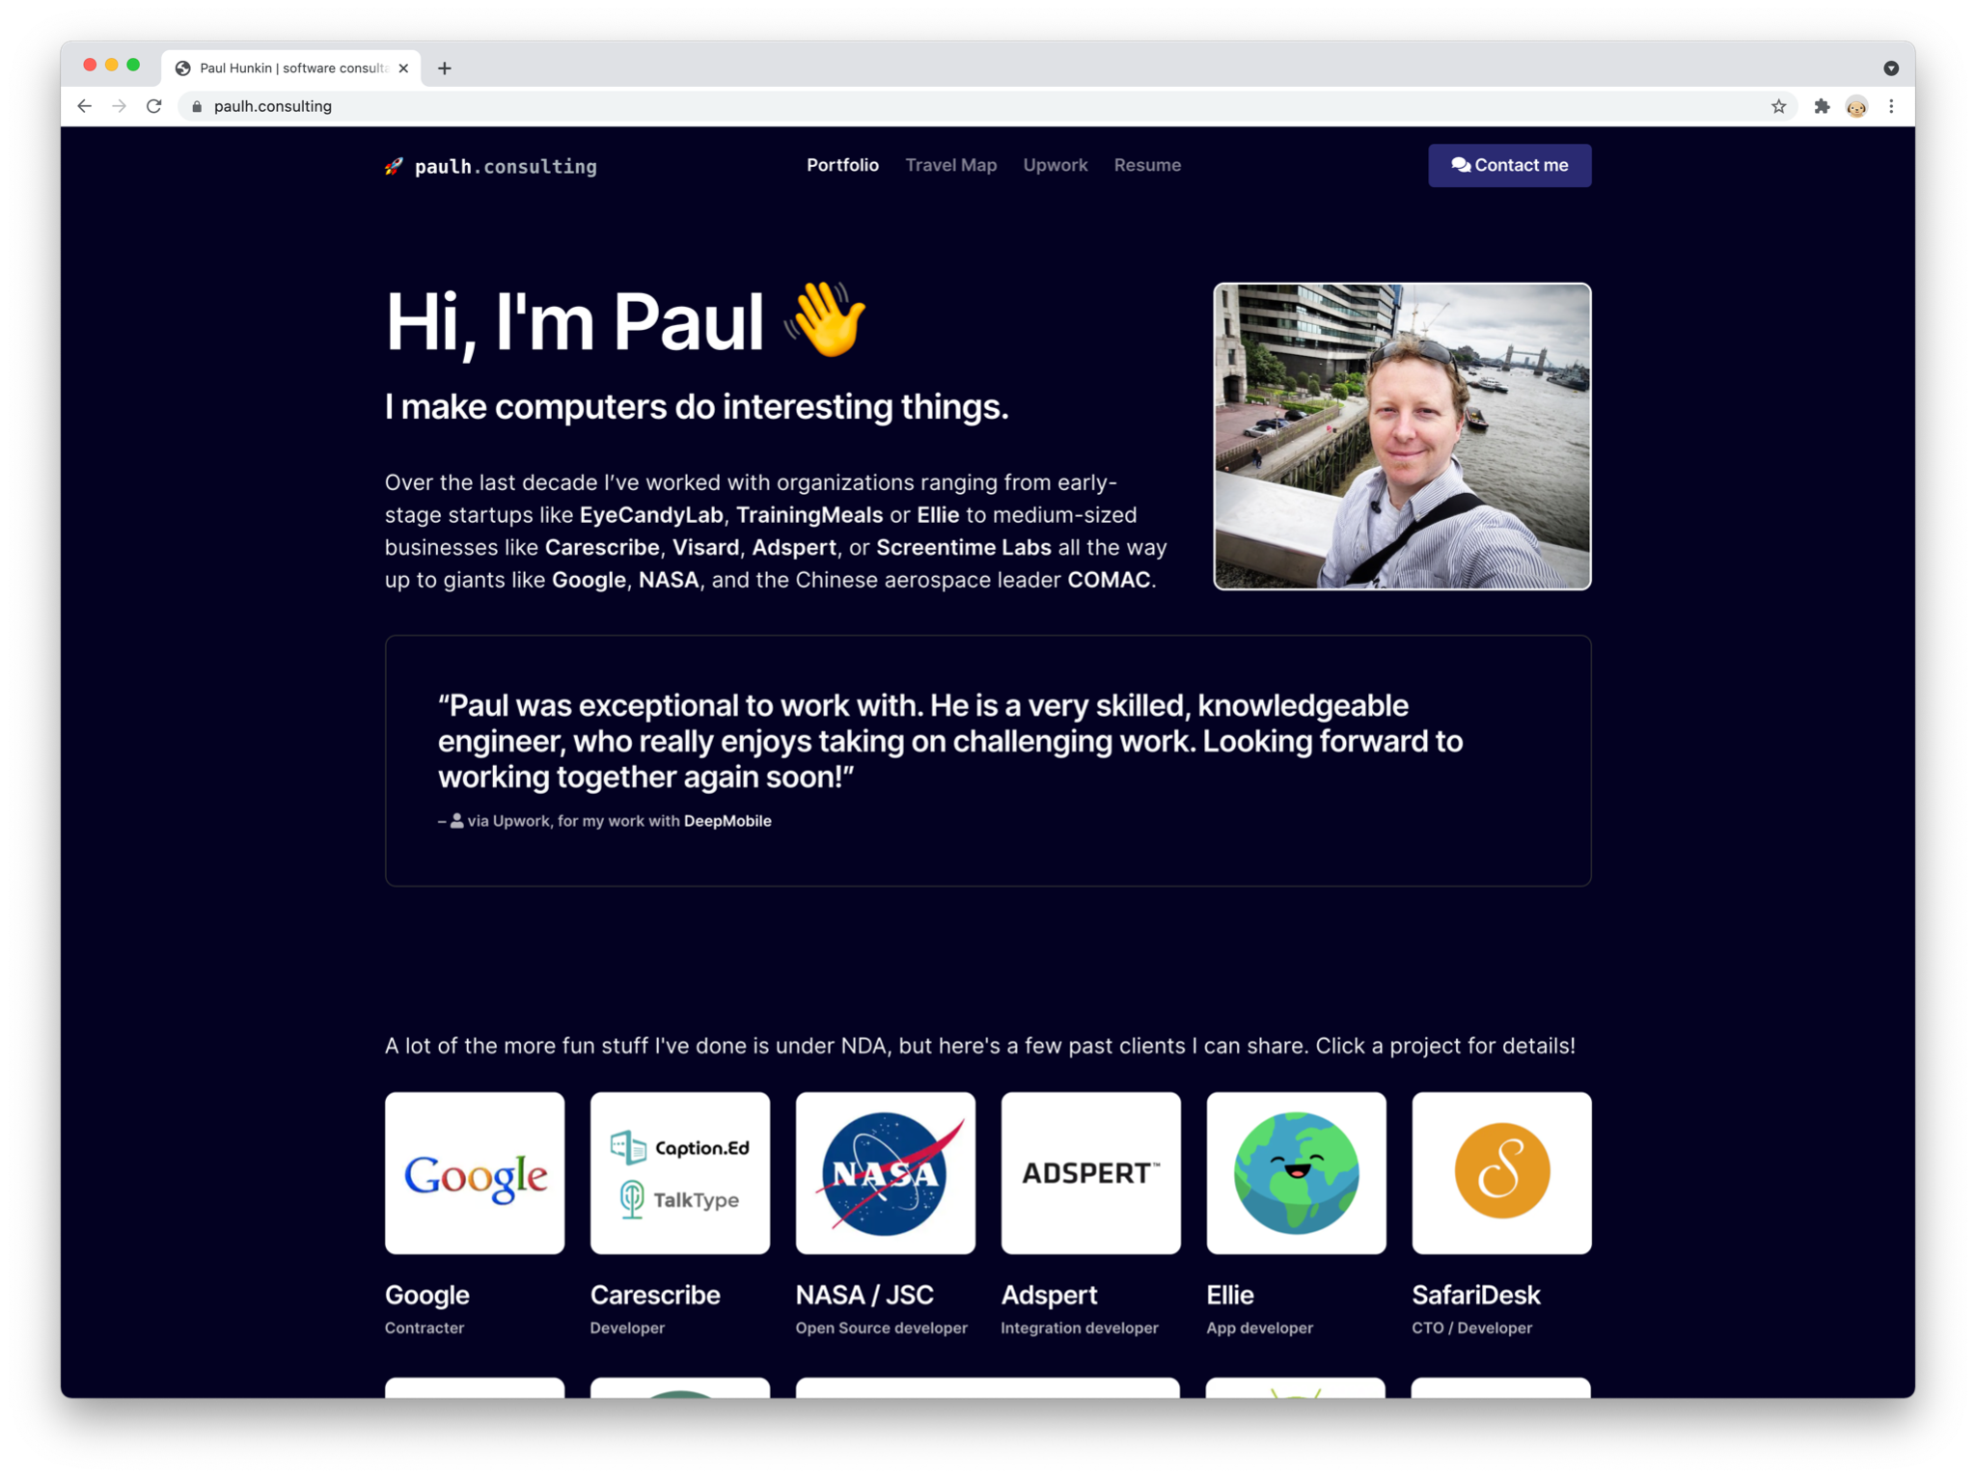
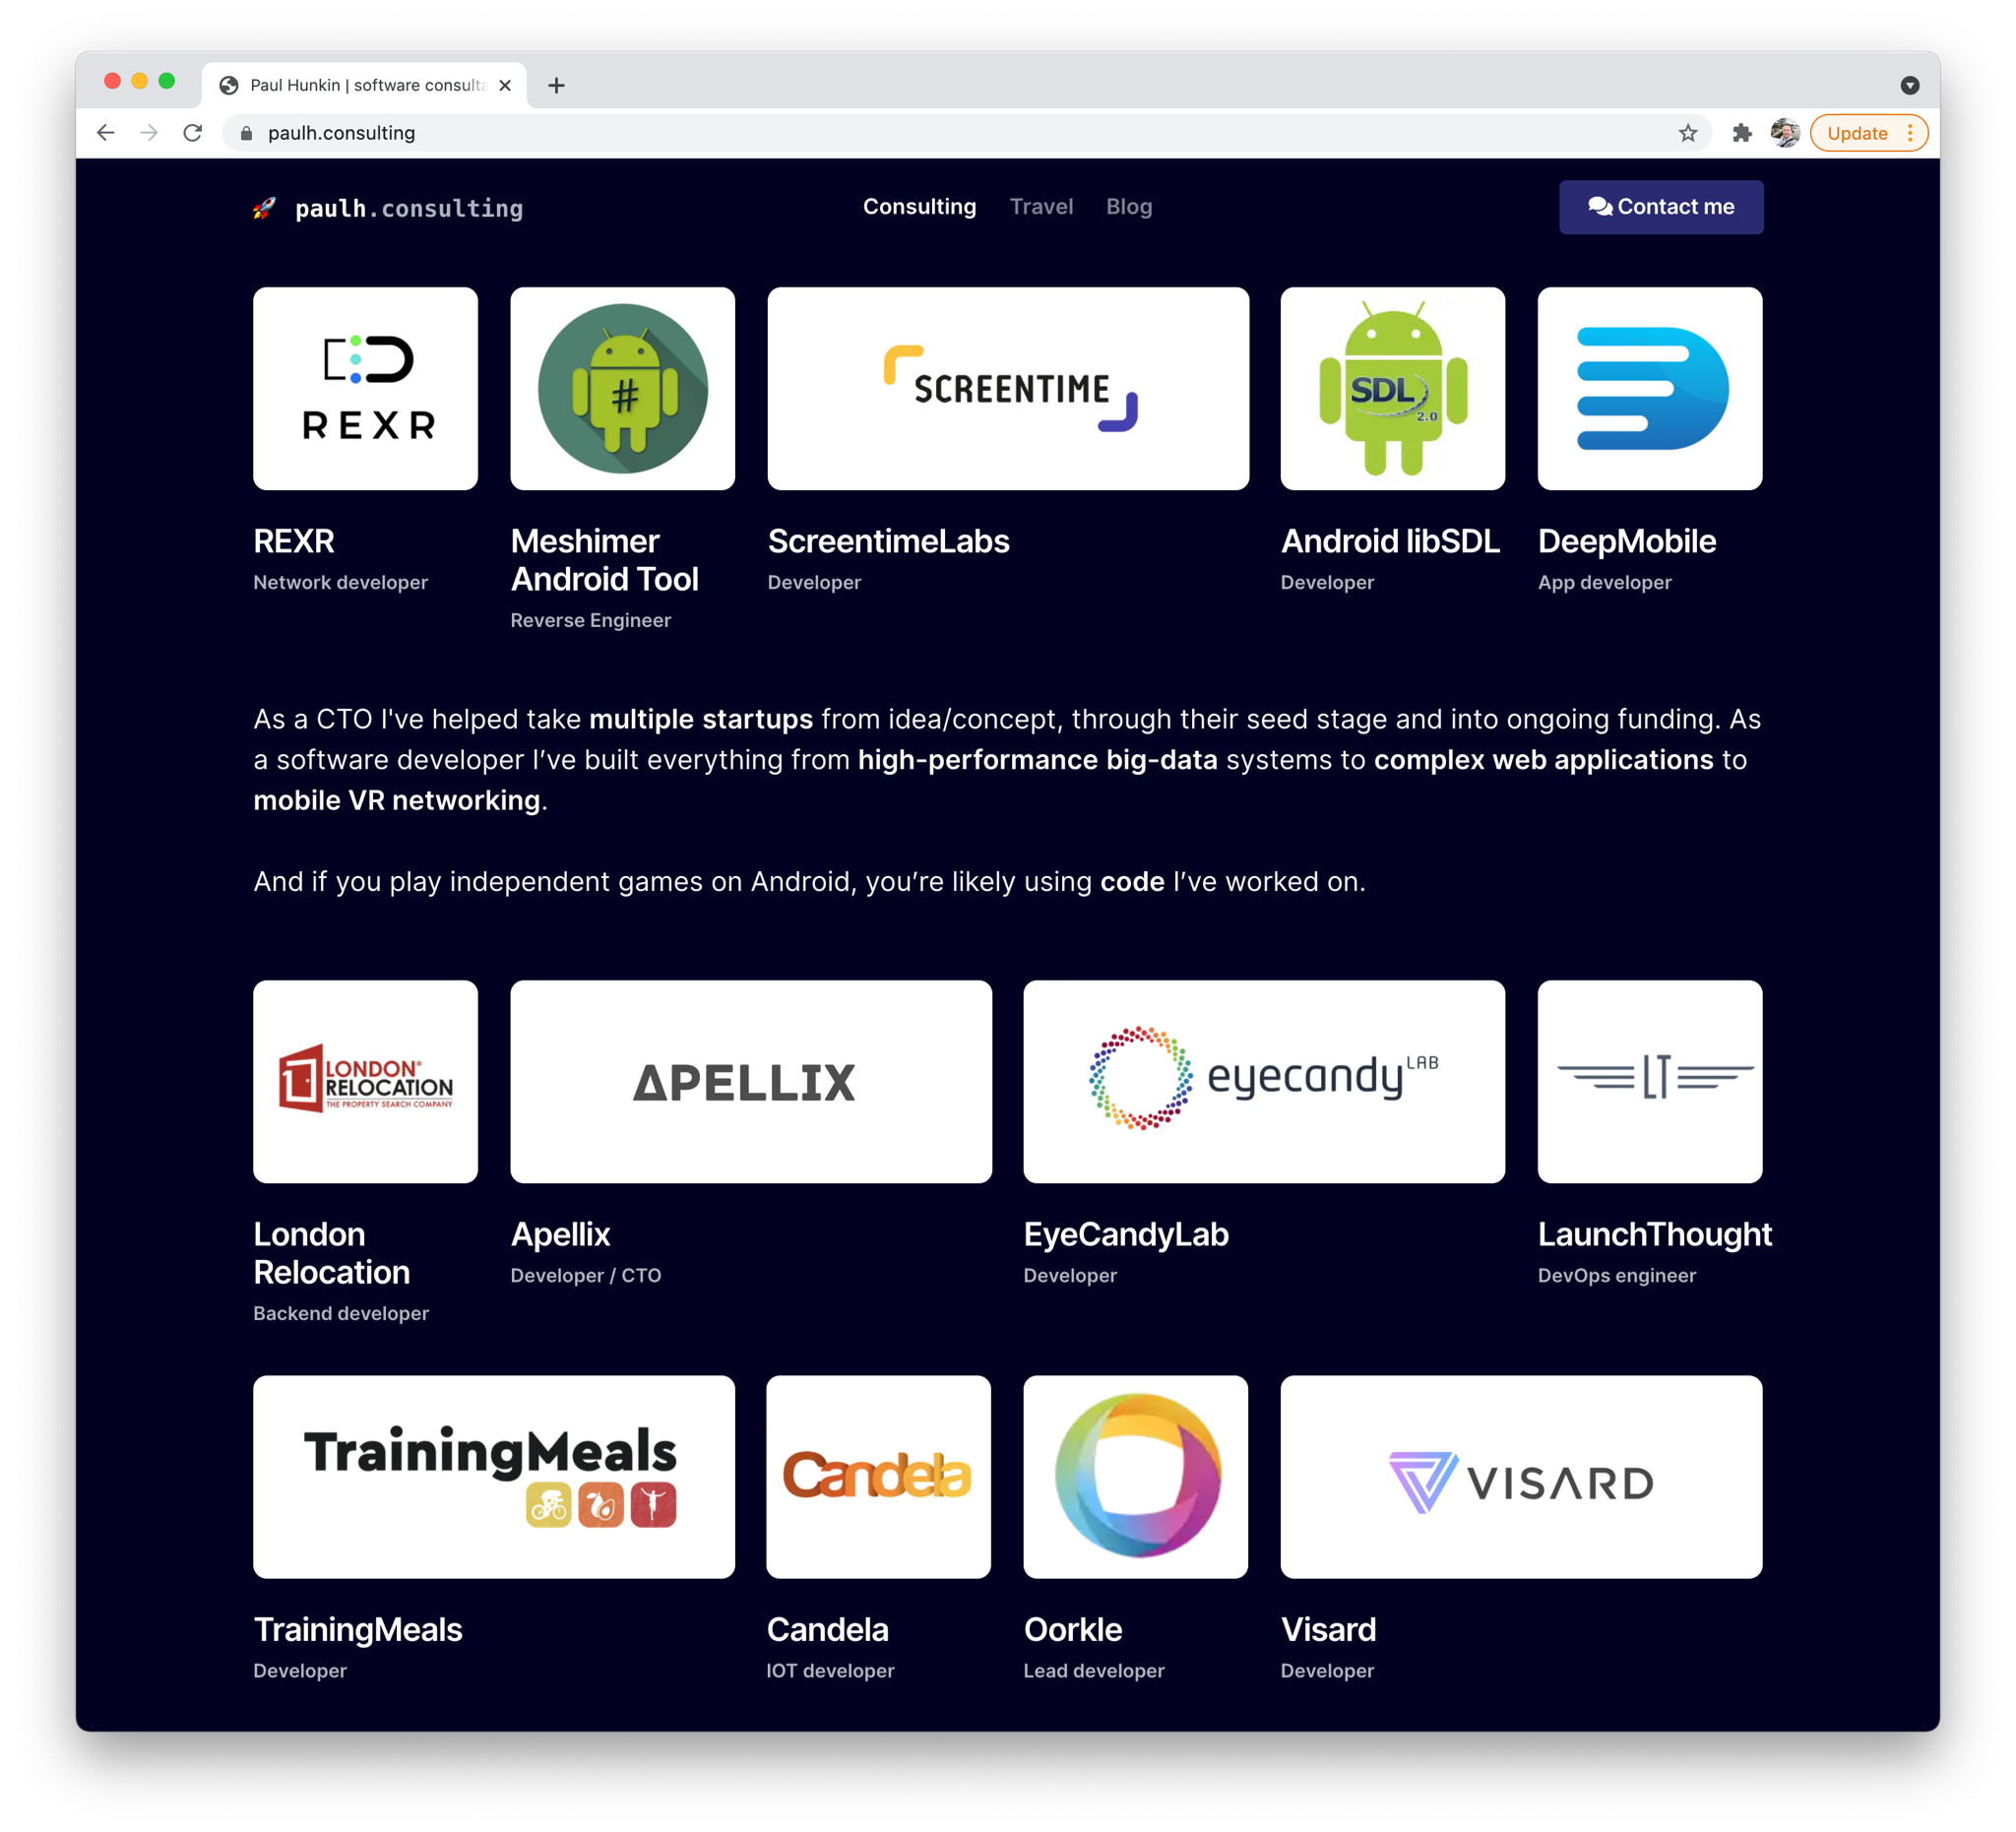
Background
Notes:
These days I mostly like to work with startups. It’s more flexible, and I find the projects most interesting when they’re in that … early stage startup flux. I do rather enjoy being able to contribute to the shape and direction of the product, which is easier to do at a startup, rather than a big-co.
But I’ve worked with big companies too. For example, NASA used some open source distributed rendering systems I’d built and then Google helped fund the development.
While most of my work now is direct inbound or referral, I still maintain an Upwork profile. It’s how I got started, and it’s still useful today.

Slide 8
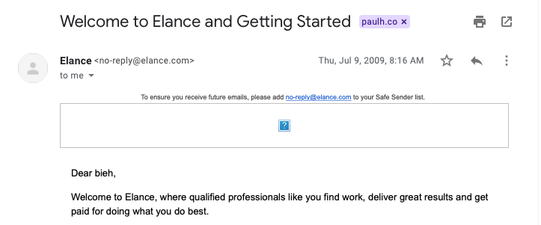
On Upwork before it was Upwork!
Notes:
But, we’re here to talk about Upwork. So how did that start? Back in the day, it was Elance.

Slide 9
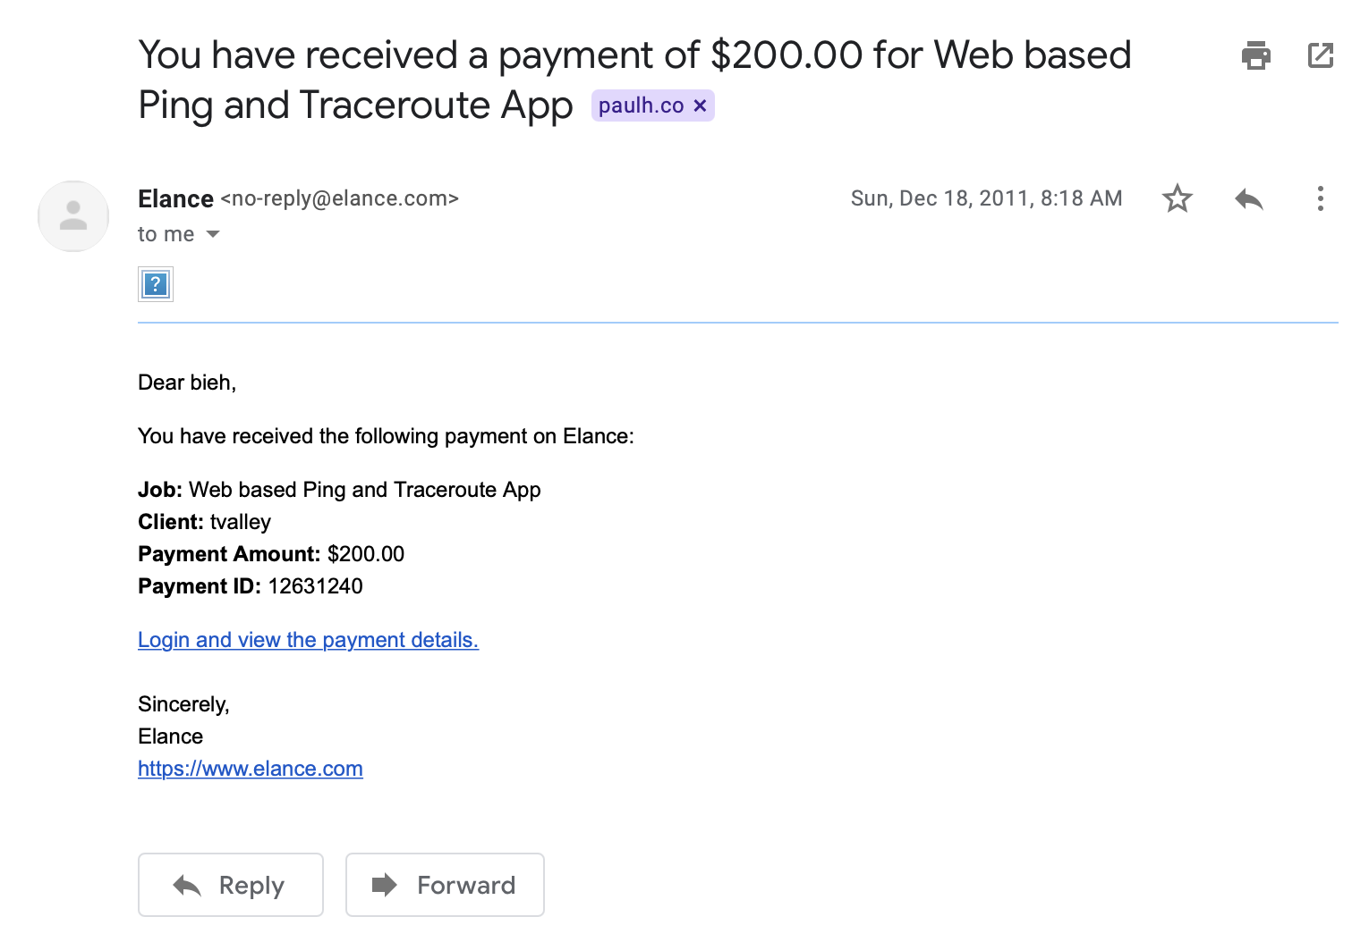
On Upwork: 2011 to 2021

Slide 10
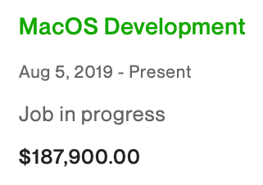
On Upwork: 2011 to 2021
Notes:
About a 1000-fold increase in payment.

Slide 11
On Upwork: 2011 to 2021
How did I do that?

Slide 12
CAVEATS
This kind of stuff works well for… open ended consulting work, especially in IT, where there’s a massive gap between what people charge, and you can position yourself at the premium end of the market.
There’s other domains (translation? copywriting?) which appear to be much more constrained with per-word rates and the like. I’m not sure how applicable this all is to them.

Slide 13
CAVEATS
I came from a position of being technically skilled but not knowing how to communicate or land clients.
If you’re not good at what you do, your first step should be to skill up!
(at least for engineering/CS -- other fields may vary)
Notes:
“Being a good developer” is table stakes.

Slide 14
First attempts (2011):
I’d been working in network research at my university. Great! I had technical skills!
Notes:
First let’s go back to the original attempts

Slide 15
First attempts (2011):
I’d been working in network research at my university. Great! I had technical skills!
“I’ll search a few technical terms like ‘ARP’ and ‘link-layer’ and find someone who needs stuff like that.”
“I’ll optimise by writing some generic text that applies to all of the jobs, that’ll save loads of time”
“These were posted months ago but they’re still here! They must be getting desperate…”
“Some of these jobs look like they’re posted by business people, yuck. Forget those.”

Slide 16
First attempts (2011):
Atten: hiring manager,
I would like to apply for your job recently posted on elance.com. Please find attached my resume and academic paper publication history for your perusal.
I estimate the cost for this project will be US$1,000.
Regards,
Paul Hunkin

Slide 17
First attempts (2011):
Atten: hiring manager,
I would like to apply for your job recently posted on elance.com. Please find attached my resume and academic paper publication history for your perusal.
I estimate the cost for this project will be US$1,000.
Regards,
Paul Hunkin
The only work entries were “Grad school + teaching students”
A set of incredibly esoteric and academic topics

Slide 18
SO MANY THINGS WRONG...
I sounded like a robot 🤖
Generic letter: projects on Upwork get dozens of identical copy-paste applications
Applying to old jobs
Not providing any proof of ability to do the work
Talking about money up front.

Slide 19
#1 tip: sound like a competent and interesting person.
Notes:
This is the most important tip, so I put it first. I realise this is … soft and fuzzy people skills stuff, which I absolutely did not get into computer science to deal with. I just wanted to sit in a corner and write some code and not talk to people.
But the rewards from being able to communicate with people and connect with them, have paid off so massively over the years, it’s hard to overstate.
This applies to both the proposal and interview stage, and also when you’re actually working.

Slide 20
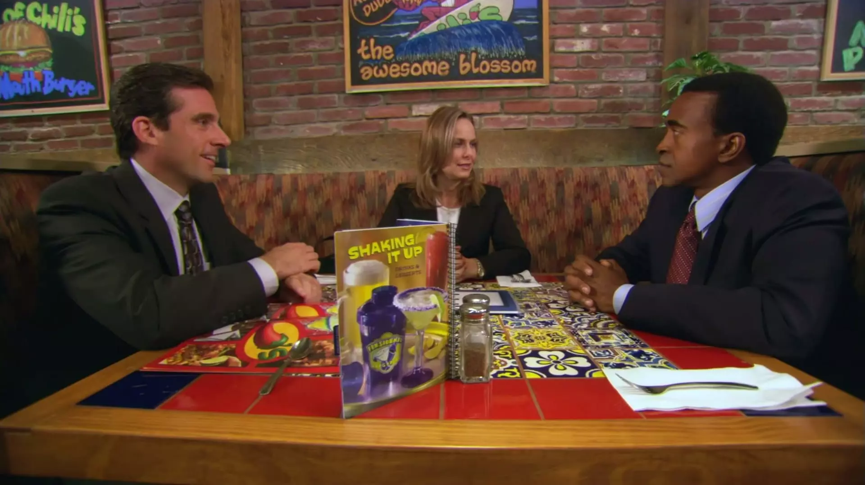
#1 tip: sound like a competent and interesting person.
Notes:
Like I’m sure many people watching this also did, I spent the pandemic marathoning the Office, for the first time in a very long time. And when I got to this episode (2x07), it stuck out to me a bit. Despite nominally being a comedy, it’s really got it pretty accurate here.

Slide 21
#1 tip: sound like a competent and interesting person.
Much like Michael Scott: you’re never going to compete on price. Clients are always going to have a cheaper option than you.
So you need to make a personal connection, while at the same time convincing them of your technical capabilities.
You want the client to say: “Hey, Paul is really expensive. But he seems like a good guy, he’ll get the job done well and he’ll be easy to deal with and won’t need a lot of handholding. So let’s stretch the budget”.
(exactly what happened in The Office!)

Slide 22
#1 tip: sound like a competent and interesting person.
In other words, people like to work with other people they like.
They want an enjoyable experience, not just someone to do a job. That's one of the requirements for charging higher rates. If they don't like you, they’re not going to hire you.

Slide 23
#2 tip: move fast without breaking things.
You want to be in the first couple of proposals to a job. Within an hour, max. Use Upwork filters and third-party alert extensions to make sure you’re there right away.
If it’s in the daily “jobs you might be interested in” email, you’re too slow.

Slide 24
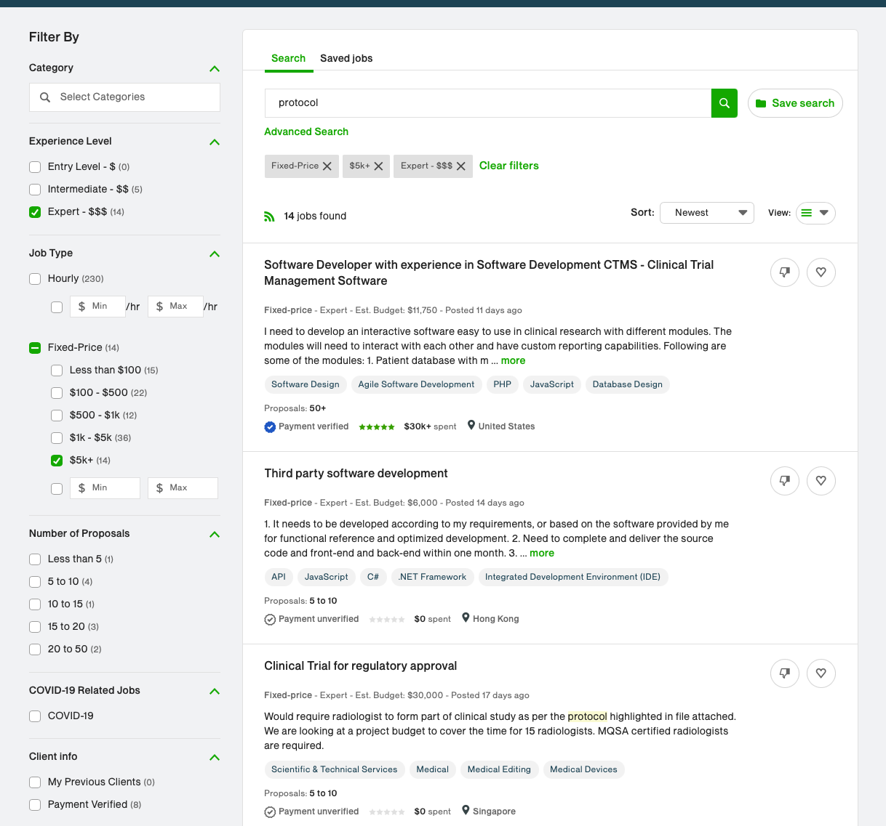
#2 tip: move fast without breaking things.
Notes:
Advanced search filters are your friend!

Slide 25
#2 tip: move fast without breaking things.
Notes:
These filters on the Upwork side are handy. Click left to right, look at the first page. Anything there? Great, take a closer look. If it’s fallen off the first page? TOO SLOW.

Slide 26
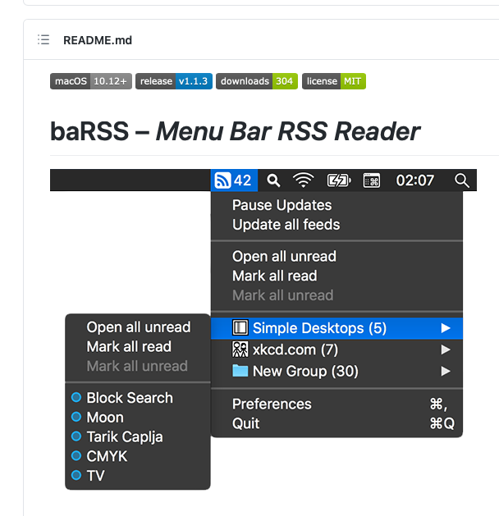
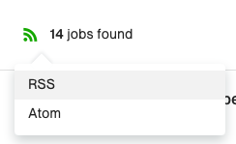
#2 tip: move fast without breaking things.

Slide 27
#2 tip: move fast without breaking things.
IMPORTANT: the only point of a proposal is to get the client on a call. That’s where the magic happens.

Slide 28
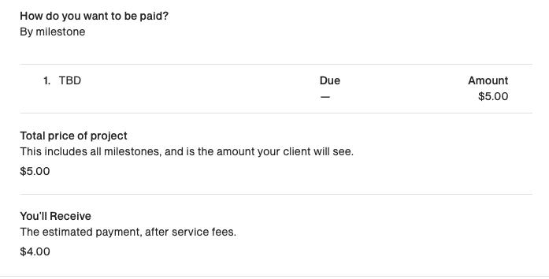
#3 tip: don’t talk about money in the proposal
Only talk about money once the client is mentally committed to hiring you. ie: after or on the call.
Notes:
Obviously there’s lots of methods for talking about price. But this works for me. Remember, at the proposal time, your main goal is to get them on a call. That’s where you talk about price. When the client is reading your proposal, they don’t know yet that you’re awesome and that you’ll make their life way better if they can afford you. You’re just another faceless entry in the proposal list, and you don’t want to give them a reason to trash your application. I put a $5 bid on the proposal, clearly marked as TBD, and mention on Messages that we’ll discuss budget once I’ve got a better idea of the scope of the project. Is that unethical? I don’t think so, as long as it’s marked clearly as a placeholder.
If you go back to Michael Scott earlier, he didn’t lead with the high price he wanted. Nor should you. I talk about price right at the end of a call, if necessary saying things like “Well I want to hear all about the project first”.
Obviously this isn’t without risk. What if you do a whole call with them, and then at the end you ask for $10k and it turns out their budget is $100? That’s a waste of time. And yeah, that’s a risk, but it’s more than offset by being able to turn a $5k “hard budget” into twice that, just by being the one they really want to hire. Worst case, you wasted an hour.
And if they say: “sorry but the budget really is 5k”. Have some fallbacks. Compromise on scope instead. “Well, how about if I do xyz for the 5k, and we leave abc till after launch as a phase 2?”.
(can’t win them all. But you’d be surprised how many you can)

Slide 29
#3.1 tip: the “budget” isn’t necessarily the budget
Notes:
Upwork UI makes it really hard to find the original posted budget. But here’s one past job of mine. Posted with a $1500 budget.

Slide 30
#3.1 tip: the “budget” isn’t necessarily the budget
Notes:
...but the eventual billables were $13.5k.

Slide 31
#4 tip: learn to recognize opportunities.
What is the “perfect project?”
Fits your Upwork filters: High budget, verified payment, etc.
Low number of proposals + recently posted
Low amount of effort (for you) needed to complete, relative to the amount you’ll bill
Slightly vague specs, perhaps posted by someone willing to pay more for someone relatable who will help refine. Look out for “consultation” as a keyword.
OR
Something very specific posted by someone who knows what they’re talking about, but only where you know a lot about the domain and can be very specific in return.

Slide 32
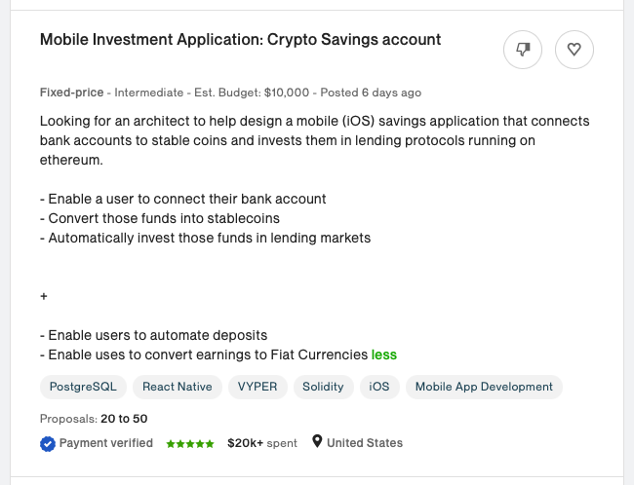
#4 tip: learn to recognize opportunities.
Notes:
High budget even by default. Looks like a startup -- ask about their VC status on the call, potentially plenty of wiggle room in the budget
Technical details but they want an architect. Suggests they don’t know exactly what they need yet.

Slide 33
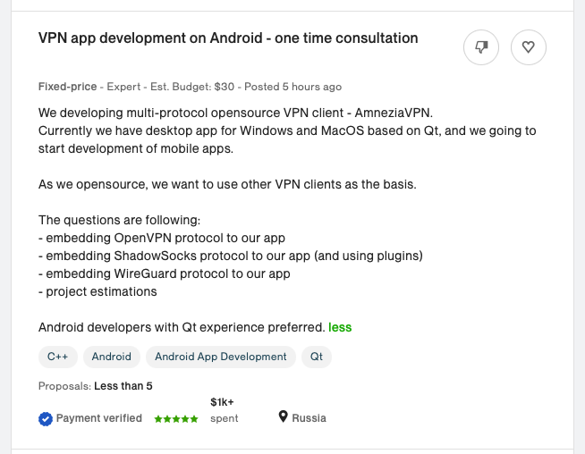
#4 tip: learn to recognize opportunities.
Notes:
$30 budget… but it’s for a consultation. Offer $100 for an hour consult. Then who are they going to talk to, to build the big system? You.

Slide 34
#5 tip: Keep it short but relevant
People are lazy and don’t want to read a lot.
Don’t put too much text in a proposal. Remember: The only function of your proposal is to get the client interested enough to get on a call.
(This is much easier nowadays because everyone is on Zoom anyway. Thanks, COVID!)
But it has to be enough to pique their interest.

Slide 35
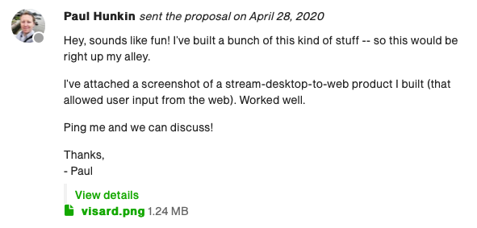
Examples of winning proposals?
I’m not very imaginative. I tend to use the same structure every time.
Enthusiastic opening
Proof of previous work/expertise in shipping actual related product
Call to action: a discussion to get them started.

Slide 36
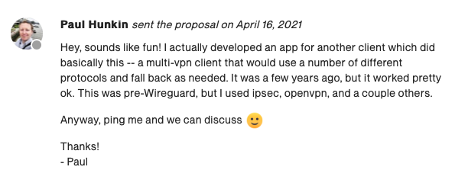
Examples of winning proposals?
I’m not very imaginative. I tend to use the same structure every time.
Enthusiastic opening
Proof of previous work/expertise in shipping actual related product
Call to action: a discussion to get them started.

Slide 37
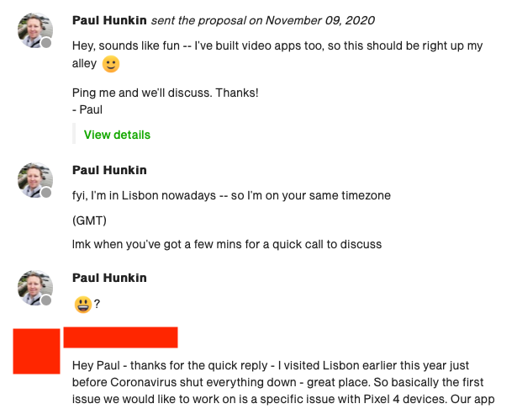
Examples of winning proposals?
I’m not very imaginative. I tend to use the same structure every time.
Enthusiastic opening
Proof of previous work/expertise in shipping actual related product
Call to action: a discussion to get them started.

Slide 38
You landed the interview...now what?
Key goal: Convince the client that by hiring you, you’ll make their life easier than if they hire someone else.
“I get on with Paul better than the other applicants I talked to”
“He has lots of other ideas”
“He understands what we’re trying to do on a deeper level, without me having to explain”
“He’ll be able to work independently without me micro-managing him.”

Slide 39
Time to talk money
The eternal conundrum: how do you know how much to charge?
Notes:
{Tell story of guy in BKK}

Slide 40
A note on how to charge
The amount you bill a client and the amount of time+effort you put into the project should not be connected*
The amount you bill the client should be proportionate to the amount of value the client derives from your work.
* except insofar there’s a lower bound you won’t go below
IN OTHER WORDS
Always work on a milestone basis. If the client wants something built that they get $100,000/year in value from, they’re going to be willing to pay some fraction of that to you to build it.
If you know how to do this quickly because you’re smart or you’ve done it before... you could charge $100*10 for the ten hours it takes you.
Or you bill them, say, $25,000 lump for it -- and the client is still happy, because they’re making a 4x profit, and you’re happy because you’ve got 25k for a days work.
Why does this work?
Notes:
This is down to psychology. I don’t quite understand it either, frankly. But I think it’s because when people are faced with a request for a very high hourly rate, they balk because they’re used to comparing hourly rates between people. It’s a very easy way to compare people. I had a client say “no I can’t pay you that, even I don’t get that per hour!”. No matter that he was on salary and so it’s not the same...
When you ask for a lump sum people think of it in terms of buying “a thing”. It’s a different calculation. And who’s to say how much the thing costs? Well, that’s you, the thing expert. If you say it’s worth $5k, or $10k, or $50k… well, what, are they going to say that’s wrong?
So the end result is, if I say: “To build the thing it’ll take a week and my rate is $150/hr”, they’ll balk. “But if I say: to build the thing it’ll be $10k lump”, they’re happy. Even though the lump is more!

Slide 41
A note on how to charge
If you are confident enough in your work to charge a fixed price, conversations with the client become really easy: "Is it worth $X to you for me to do Y?"
Most clients have a good sense of the answer to that question. If they don't, it’s a red flag and there’s a good chance you don't want to work with them anyway.

Slide 42
How to know how much value you’re bringing?
Try and estimate how much value your work will bring the client
“How many users will this SAAS product have?” → estimate client revenue from pricing for SAAS
“Oh you want me to build an iOS app to go along side your Android one? Neat!” → Check the Android app usage, calculate guesstimate of iOS usage.
Google the company: VC funding? Acquisitions? Check Companies House etc.
From there, estimate (at least to a number of zeros) how valuable your work will be to them. Then, that lets you figure out how much to charge them.

Slide 43
Pick a number.
Rule of thumb: ask for more. You’re not asking enough.
(How do I know that? If you were billing the most you could, you wouldn’t be listening to this talk for tips. )
General tips:
Be confident and assertive with your $ figure. You’re the expert. You say what your work is worth. Be prepared to back up why your work is worth that much.
The more expensive the project: the better the client. My most annoying clients have always been the cheapest.
The more you charge, the more seriously people take you.
You’ll be too expensive for many people. That’s fine.

Slide 44
After the call
Do a followup message (“hey, thanks for the call, super interesting project, I’m really excited to be working with you”)
Confirm your $. Research and figure out a concrete billable amount.
Send over a written development plan/spec ASAP. I have a set of Google Docs templates that make this easy. Pad it out with “concept” images to bulk up the page count.
If they’re on the fence about confirming: don’t be afraid to apply some FOMO time pressure. “Hey, I’ve got other projects who want to start at the same time, let me know if this is going ahead”

Slide 45
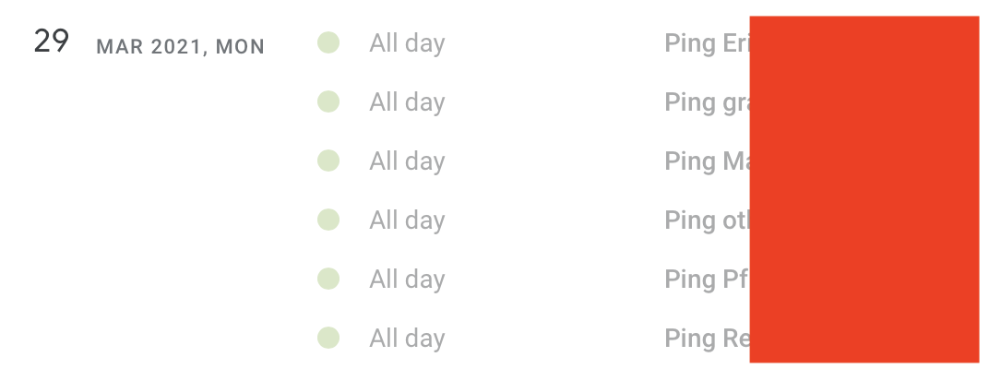
What if you didn’t get it?
You’re excellent at what you do and the client loved you. But it didn’t quite all come together.
Follow up with them later. They’re part of your network now! Set reminders so you don’t forget.
Every Monday I spend some time following up with past clients and prospective clients. I have them up to six months out. Annoying? Perhaps. But reminding a client that you exist can convert into fresh projects a long time down the line.

Slide 46
In conclusion
Finding jobs: Be selective but fast
Proposal: Sound human, friendly, get on a call ASAP
Interview: Convince the client that hiring you will make their life easier and better. Talk about money only once they’re convinced of your excellence.
After the call: Follow up promptly with professional specifications and docs.
Later: Keep in contact. Network!

Slide 47
Questions?
paul@bieh.net
https://paulh.consulting

